Slide 1

Dynamic Time Warping, DTW
Tóth László
Számítógépes Algoritmusok és Mesterséges Intelligencia Tanszék

Slide 2
Pattern recognition by
Template Matching
The simplest pattern recognition approach that does not require expert knowledge is based on comparing patterns (template matching)
In the learning phase we store one example (reference pattern) for each unit that we intend to recognize
In the recognition phase the unknown input is compared with each stored reference, and the one which is the most similar is returned as output
  Th accuracy of the system will depend on the accuracy of the actual similarity metric (distance measure) used
  We can consider this as an extreme case of machine learning where there is only one example for each class
In the case of speech recognition, the most successful template matching algorithm was the dynamic time warping (DTW) algorithm
  Words or short expression were used as the units of recognition

Slide 3
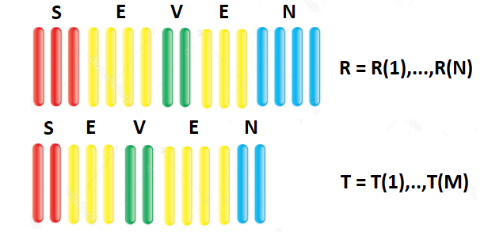
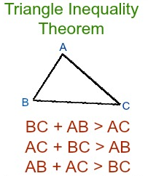
Distance functions
We assume that the words have gone through feature extraction, so they are given as sequences of spectral vectors
  R: reference, T: test
We have to define a distance function that measures the similarity
(difference) of two words
The mathematical requirements of a distance function d:
  Non-negative and d(R,T)=0 if and only if R=T
  Symmetric: d(R,T)=d(T,R)
  Satisfies the triangle inequality

Slide 4
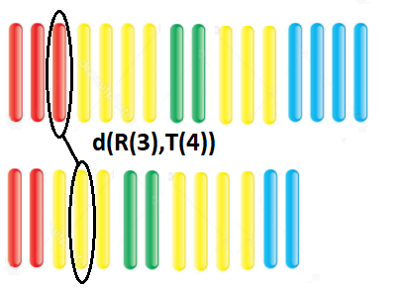
Local distance functions
We will construct the D(R,T) distance of two words from d(R(i), T(j)) local distances
Ideally, d is small when R(i) and T(j) belong to the same phone, and d is large when they are from different phones
  In the 80’s several distant functions were proposed, depending on the actual preprocessing method
  Some of these are not symmetric – in that case they should be called „distortion measures” rather than „distance measures”
  For example, for cepstral vectors (c₁[n], c₂[n]) the weighted Euclidean distance works fine:

Slide 5
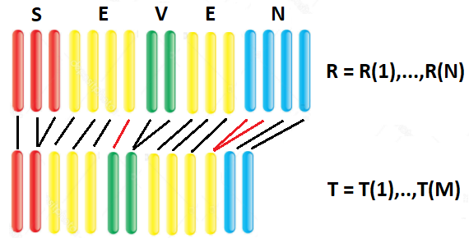

Linear time warping
How can we define the distance D(R,T) of the two sequences from the local distances d(R(i), T(j)) of vetros pairs?
  Idea: let’s take the sum
  of the distances
1st. Problem: the two sequences may have different lengths: N!=M
    Solution: we can stretch the shorter one linearly, that is, the pair of
    R(i) should be T(round(i*M/N))
2nd. Problem: the talking rate may change within the word, so with a linear stretching it may occur that vectors from different phones get paired, even when the two words are the same (see the red pairs in the image)
  So we can obtain a non-zero distance even when the two words are the same

Slide 6
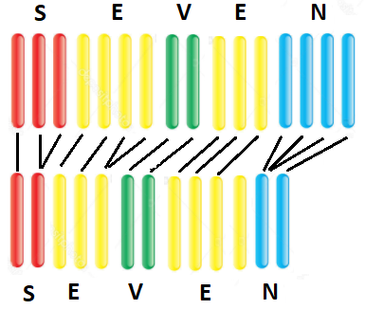
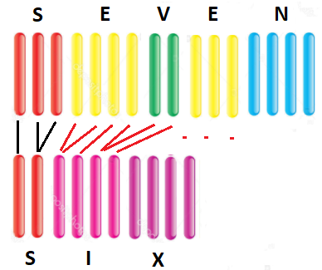
The basic idea of time warping
3rd. Problem: we don’t know the position of the phones within the words
  So we cannot find the optimal pairs of the vectors
Solution: Let’s calculate the D distance for EACH possible pairings, and define D(R,T) as the minimum of these distances!
What is the sense in this?
When the two words are the same, we get the smallest distance when each vector is paired with a vector from the same phone (see left)
When the two words are different, no pairing can return a small distance (see right)
Remark: We will return to such cases like “ten” – “net”

Slide 7
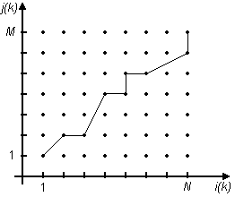
Formalizing the DTW concept
To formalize the concept, we introduce a shared time axis, k (k=1…K)
  We will compare K pairs of vectors from R and T
  the i(k) and j(k) functions will tell the index of te actual vector taken from R
  and T at the kth time instance ( and )
This way, any possible pairing can be defined by specifying the i(k) and j(k) functions
  Placing the elements of R along axis x
  and the elements of T along y, any
  possible K-step warping corresponds to
  a path in the figure:
The global distance for a given path:
And the distance of R and T is defined as:

Slide 8
Path constraints
Formally, we should evaluate all possible paths, but when we match speech signals, many possible paths simply make no sense
(for example, mapping all elements of R to T(1))
  We introduce constraints to remove the nonsense paths
1. Endpoint constraints
  The pair of the first vector should be the first vector of the other sample, while the last vector should be paired to the last vector
  In the figure, this means that all paths should start from (1,1) and end in (N,M)
  Formally:
2. Monotonicity constraints
  Speech can become slower or faster, but is cannot turn back
  This means that i(k) and j(k) are monotonically increasing (non-decreasing)
  In the figure, paths cannot turn back along any axis
  Formally:

Slide 9
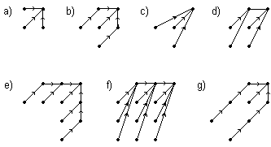
Path constraints 2
3. Local continuity constraints
  Speech can become slower or faster, but its speed changes slowly. We can exclude all the paths that make quick changes, for example, paths that jump along any axis
  These constraints are hard to formalize, so they are given by specifying the set of possible steps or short step sequences, for example:
  The steps are given backwards, that is, we specify the possible previous positions for the actual position – we will soon learn why

Slide 10
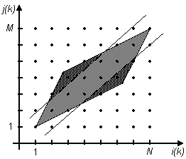
Path constraints 3
4. Global path restrictions
  Due to the continuity constraints, the path cannot reach certain parts of the plane; The grey shaded area shows the reachable points
  The global path constraints do not allow forming pairs for which the absolute time distance is too large. Formally:
  In the figure this means that the two corners of the paralelogram are cut
  (that is, we do not allow the path to stray too far from the diagonal that corresponds to linear time warping)

Slide 11

Weighting the steps
The algorithm van be refined further by mapping weights to the steps
We can use the weights to punish the unlikely steps (for example, those that deviate from the diagonal steps corresponding to linear stretching)
On the other hand, the weights helps us make the paths more comparable (for longer paths we have to add up more values, so we are more likely to get a larger distance than for shorter paths)
One example of step weighting:
And the distance function that incorporates the weights will look like:
The role of W is to normalize the different paths, that is, to make the paths of different length more comparable

Slide 12
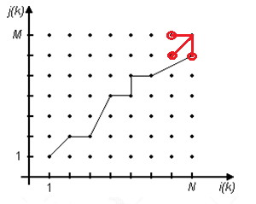
Efficient computation of DTW
We defined the algorithm, but can we evaluate it in a fast way?
  The number of possible paths (without constraints) is (NM)^{K}
  The constraints discard several paths, but their number is still exponential
  We have 100 vectors per one second, so the above number is too large
  And we have to repeat the calculation for ALL the references
Fortunately, the minimum cost of all the paths to (n, m) can be calculated recursively from the minimum costs of the paths to (n’, m’) „ancestors” of (n, m) :
  This means that D can be calculated with
  NM operations instead of (NM)^{K} using
  dynamic programming!
This is why the method is called dynamic programming

Slide 13
Forming reference patterns from many samples
Can we still use DTW when we have more than one training samples for our recognition units?
Simple idea: let’s create the reference pattern by taking the mean of the corresponding samples
Problem: our samples are vector sequences, their length may be different
Let’s define the mean of two samples the following way:
  Find the best alignment of the two sequences using DTW
  Create the reference taking the average of the vector pairs mapped together
If we have more than two samples, then we can add them to the reference one by one
  Reference = the average of the first two samples
  Referencia = the average of the reference and the third sample …
  And so on

Slide 14
Forming reference patterns from many samples 2
Some words may have two different pronunciations; we can create more than one references for this word using a sort of online clustering:
  Let’s take the first sample as reference #1
  Take the next sample, match it with #1 using DTW
  If their distance is below a threshold: reference #1 = mean(reference, sample)
  If their distance is large, we create a new reference: reference #2 = sample
  And so on, each new sample is either fused with one of the existing references, or a new reference is created
The references are created by a sort of statistical method (mean is the simplest from of statistics…); next, we will move to the statistics (machine learning) based methods, which apply more professional techniques to estimate the distribution of the training samples
Using machine learning will also exclude the need for manually tuning parameters like the weights or path shapes (well, sort of…)

