Slide 1

Preprocessing methods
Tóth László
Számítógépes Algoritmusok és Mesterséges Intelligencia Tanszék

Slide 2
Introduction
As in the case of any machine learning task, ins pseech recognition also the first step is feature extraction, that is, to find a good representation of the input data
In speech recognition, the feature extraction step is also known as pre-processing, and the module that performs this is called the „front-end”
For speech recognition – similarly to any other machine learning tasks – a good feature vector should be small, but contain every relevant factor
  It should contain all the information that helps solve the actual task
  All variances that are not relevant for the actual task should be removed as much as possible
  It should be small in size
Finding a dense representation is very important forspeech, since 1 second of speech corresponds to 8-48 thousand samples (depending on sample rate)
The methods that I present today all create a small feature vector, while they try to remove the non-important components

Slide 3
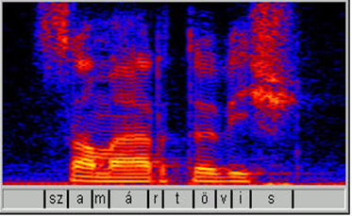
Spectrogram
The Fourier-transform gives a simple and fast tool to perform frequency analysis on speech signals
As speech is continuously changing, we perform the Fourier analysis on small (and usually overlapping) pieces of speech
  A stanrad setting is to use 25 ms windows, with a step size of 10 ms (resulting in 100 spectral vectors per second)
  The amplitude of the resulting
  components are displayed on a
  logarithmic (decibel) scale, this
  roughly corresponds to the
  perceived loudness
  The height (frequency resolution)
  of the spectrogram is 256-512 pixels,
  depending on the sampling rate

Slide 4
Mel-spectrogram
The frequency resolution of the spectrogram is too detailed: first, the amount of data is large, and second, the rough shape of the spectral envelope would be enough for us; however, the spectrogram contains such details as the pitch of the speaker, wich is noise wrt. recognition
The frequency scale of our hearing is logarithmic, while the Fourier transform creates a linear frequency scale
The linear frequency axis can be warped to the mel-scale using weighted summation, which simulates the effect of a mel-scale filter bank
We can control the amound of data returnd by setting the number of filters
  Assuming 1 mel wide filters, we need a minimum of 24-26 filters to cover the whole frequency axis, depending on the actual sampling rate
  Usually we apply a bit more filters, for example 40, or more recently 80 filters are applied, so the resulting height of the mel-spectrogram will be 40 or 80
The mel-spectrogram is a very popular input for neural network-based recognizers

Slide 5
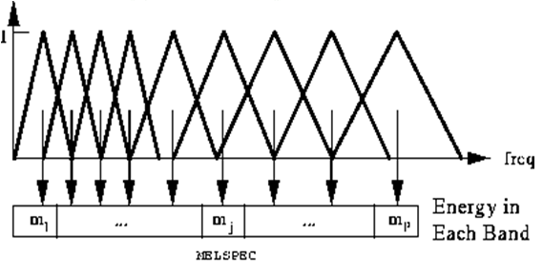
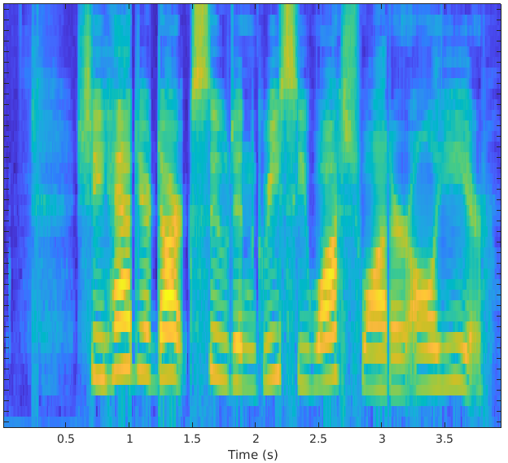
Mel-spectrogram 2
Illustration of the mel-scaled weights, and the resulting mel-spectrogram:
Obviously, the mel-spectrogram is less detailed then the normal spectrogram
  But interestingly, with a well-trained neural network the speech signal can be reconstructed from the mel-spectrogram, see the WaveNet or WaveGlow nets

Slide 6
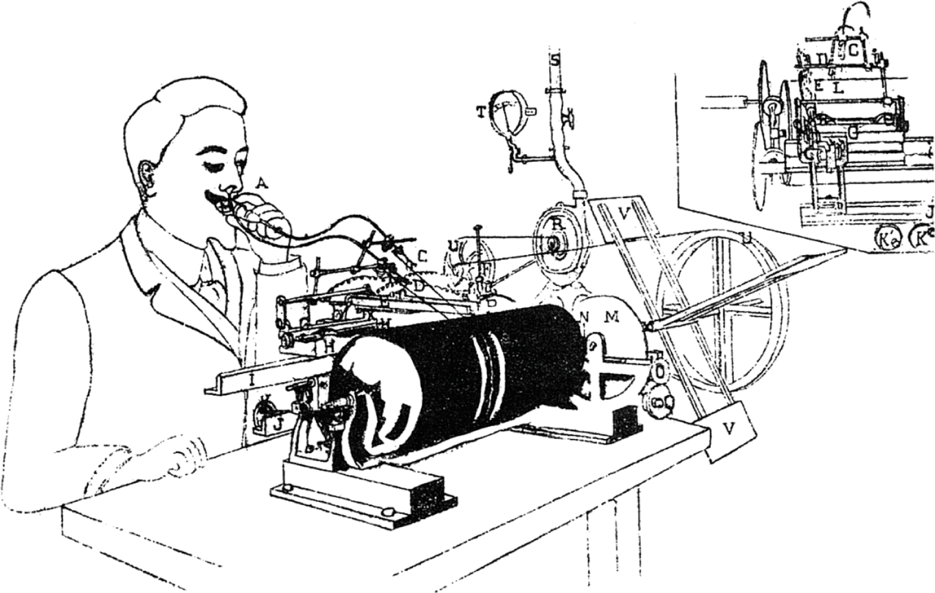
Filter bank analysis
Even before the invention of the FFT, scientist could create spectrograms using analogue solutions
  Place a series of bandpass filters filters (=filter bank) along the frequency axis
  The device had a rotating paper roll, and a pen for each filter which was pressed to the paper with a power proportional to the energy of the signal in the given bank
  Later, the same concept was implemented using digital filters

Slide 7
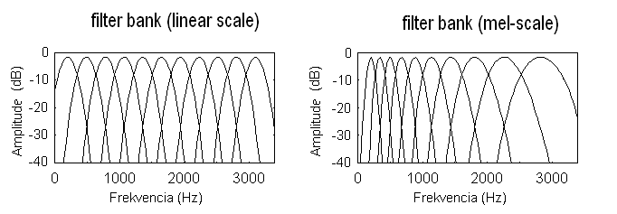
Filter banks 2
After the invention of the FFT (1965) filter bank analysis lost its popularity
  It can be shown that the FFT is equivalent with a filter bank where all the filters have the same shape and they are distributed linearly along the frequency axis
  However, the computation of the FFT is much faster
From the 90’s, filter banks became popular again:
  Computers became faster, the computation cost did not matter as much
  Using a filter bank, the filters’ shape and position can be freely changed, different from the FFT where both are fixed
  For example, we can easily create filter bank that is adjusted to the mel scale:

Slide 8
Cepstral coefficients
According to the source-filter model, the speech signal is the result of an excitation signal passing through a filter
In the spectral domain, this corresponds to the multiplication of the spectrum of the excitation signal with the transfer characteristic of the filter formed by the vocal tract
We discussed that for speech recognition the more important information is contained by the shape of the filter (the shape of the spectral envelope)
The aim of cepstral processing is to separate (or estimate, at least) the two multiplied factors, or - to put it another way - to invert the filtering process (deconvolution)

Slide 9
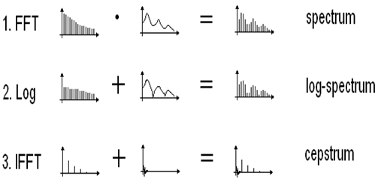
Calculating the cepstrum
The steps of cepstrum calculation (right: the speech signal we have,
left: the two supposed components):
1. First, we perform an FFT on the signal to obtain its spectrum
2. Second, we take the logarithm of the obtained components
  Logarithm turns multiplication into addition
3. Third, we perform inverse FFT (IFFT) on the output of step 2
  FFT and IFFT are linear, so the sum transformed = the transforms summed

Slide 10

Cepstrum - Explanation
Without the log, FFT+IFFT would return the original signal
However, the log between the two steps gives a twist to the process, resulting in a sort of “inside-out” spectrum
  This is why its inventors gave the name “cepstrum”
  Similarly, the horizontal axis is not frequency, but “quefrency”
For real signals, and if we ignore the phase, the effect of FFT and IFFT are the same, so we could have used FFT as well
  This is why cepstrum is sometimes called “the spectrum of the spectrum”
  In the cepstral image the slowly changing components will appear close to the origin, why the quickly changing components will be far from the origin
  The spectral envelope is smooth and slowly changing, while the excitation signal is spiky, with quick changes,
  so they will appear at different
  positions in the cepstral domain:

Slide 11
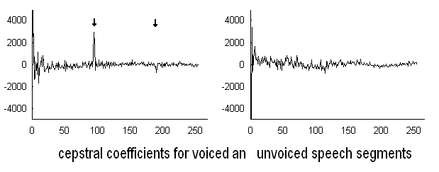
Cepstral coefficients
Example of cepstrum calculated from a real speech signal – both for a voiced and an unvoiced segment:
  Remark: you can see that
  you could also use cepstrum
  for pitch estimation!
How can we separate the effect of the excitation signal and the spectral envelope on the spectral image?
We want to keep only those components the belong to the spectral envelope, and these are at the low quefrencies
  Formally, we have to perform low-pass filtering, or „liftering”
  But in practice, we simply retain the lowest 10-20 cepstral coefficients
This way we obtained a feature vector that is both very small, and contains only the information that belongs to the spectral envelope

Slide 12
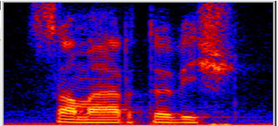
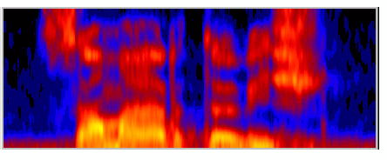
Cepstrum
The cepstrum has been the most popular feature extraction method for decades (with a slight modification, see next slide)
Using the first 13 cepstral coefficients became a sort of standard
If we want to see what these 13 preserved from the original spectrogram, then we can perform the inverse of the computation steps after liftering
(that is, after replacing the higher-index cepstral values by zero)
original after cepstral filtering
We see that liftering corresponds to a strong smoothing along the frequency axis

Slide 13
Mel-frequency cepstral coefficients
Let’s replace the normal, FFT-based spectrum with a mel-spectrum in the first step! This way we will obtain the mel-frequency cepstral coefficients, or shortly MFCCs.
The frequency axis is usually converted to the mel-scale using the simplest possible method, the triangular weighting that was presented earlier
  The practical implementations frequently apply the discrete cosine transformation (DCT) instead of the (I)FF, these give basically the same result for real (non-complex) signals
  For several decades, MFCC has been the dominant method for ASR
  Remark: The aim of the transformation in the final step is smoothing and compression. In the case of mel-spectrum this is less important (the image is already smaller and smoother due to the triangular weighting).
  However, DCT has a decorrelating effect, this is why MFCC is an ideal input for machine learning using Gaussian mixture models (GMMs)
  Neural networks do not require decorrelated features, so for them a
  mel-spectrogram is just as good as input

Slide 14
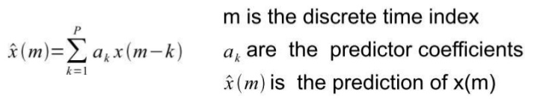
Linear prediction
Linear prediction was originally invented for speech compression (linear prediction coding, LPC)
It estimates the actual sample of the (time-domain) speech signal as the linear combination of the preceeding p samples:
We perform the calculation on one frame (20-30ms) of samples
The goal if to find such a_{k} coefficients for which the error, that is the difference of x(m) és x^(m) is minimal
There exists a very fast algorithm to find the optimal coefficients
For compression, we much preserve the coefficients and the error signal;
the original signal can be reconstructed from these, while they can be stored in much fewer bits than the original signal

Slide 15
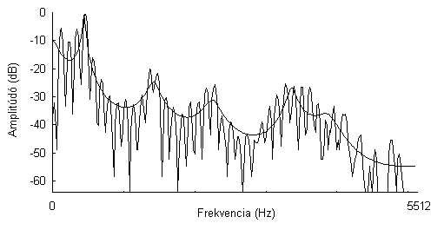
Linear prediction 2
It can be shown that the calculation performed during linear prediction is equivalent to estimating the spectral envelope by the reciprocal of a p-th order polinomial (the smooth curve is the estimate):
This is why the LPC is suitable for estimating the spectral envelope and representing it by just a handful of coefficients
We can represent the actual speech segment by just 10-20 coefficients
It was a very popular method in the 70-80’s, because it can be calculated even faster that the FFT

Slide 16
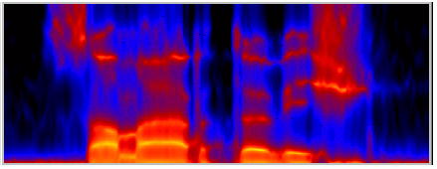
Linear prediction 3
For visualization purposes we can reconstruct the spectral view from the prediction coefficients (in this case from 12 coefficients):
We can see that, similar to the cepstrum, LPC also performs a sort of smoothing along the frequency axis
Its advantage is that it emphasizes the formants
The drawback is that it is known to be sensitive to background noise

Slide 17

Perceptual linear prediction
Linear prediction has an extended, modified version, which tries to involve the main properties of human hearing; it is called perceptual linear prediction, or shortly, PLP
Analogous to MFCC, first it calculates a kind of mel-spectrum, which is simulated by fusing the neighboring bands of a standard spectrum
  The shape of the filters mimick
  the operation of the ear more
  precisely
It also takes the equal loudness curves into consideration by emphasizing the middle frequency range while suppressing the low and high frequency ranges
It applies the cubic root formula to approximate the intensity-to-loudness mapping of human hearing
The “perceptual” spectral representation obtained this way serves as the input for the calculation of the LPC coefficients

Slide 18
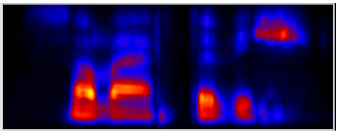
Perceptual linear prediction 2
The „perceptual spectrum” obtained before calculating the LP coefficients
  Looks similar to a mel-spectrogram
  But the middle frequency range is boosted
  And the intensity scale is also slightly different (hard to compare with our previous mel-spectrogram, because they use different color scales)

Slide 19
Auditory models
Auditory models seek to mimck the behavior of the ear as accurately as possible. They were developed with the main goal of modelling and understanding human hearing as closely as possible, but they were also tried as input for speech recognition
  Their first component is typically a filter bank that simulates the transfer charac-teristic of the hair cells (much more accurately than the filters we saw earlier)
  In the next step models the behavior and properties of neural fibers also very accurately (adaptation, saturation, …)
  They also try to model all the mentioned (and not mentioned…) phenomena,
  eg. masking (in time and in frequency), equal loudness curves, and so on
They were popular in speech recognition mostly in the 90’s
They brought a minimal improvement in speech recognition accuracy, mostly in the case of noisy speech
As the improvement was very small compared to the increase in the computation time, they did not become very popular

Slide 20
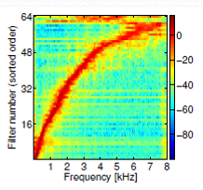
..and not using preprocessing at all?
Nowadays, in the era of deep learning, researchers seek to minimize the usage of „hand-crafted” features. The goal is to make the machine learn learn from the raw data, learning also the necessary preprocessing steps
In the case of speech recognition the “raw input” corresponds to the speech signal itself, without converting it to any spectral representation
It sounds crazy at first, but neural network-based recognizers can be trained directly on the speech signal
This is based on the fact that the operation of convolutional neurons is very similar to the operation of digital filtering (convolution)
Trained on the time-domain signal, a convolutional
neural network can learn to imitate a filter bank
that is very similar to a mel-scaled filter bank
This training is relatively slow, and the results are
not better than those with a spectral input, so current-
ly these results are more theoretical than practical

Slide 21
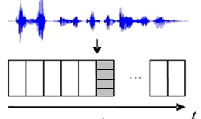
Features describing temporal changes
No matter which preprocessing method we use, they all convert the speech signal to a vector sequence, with a resolution of typically 100 vectors/sec, 20-100 features/vector
One vector describes the spectrum at one time instance, typically 20-30 milliseconds, and these will serve as input for machine learning
  However, we humans cannot recognize such short pieces of signals
  We also mentioned that the changes are in many cases more important than the actual values (e.g. the direction of change of a formant)
This is why the features that describe time trajectories were invented

Slide 22

Delta and delta-delta features
At a given time instance, the delta feature of a given feature value is defined as:
  Fit a curve (eg. a polynomial) on the actual
  value and the previous and subsequent values
  (e.g. 2-2 neighbors) of the given feature
  Calculate its derivative at the given point
This way, we obtain one delta value for each feature component at each time instance, so it practically doubles the number of features
We also often use the derivative of the derivative, the delta-delta features
These features were shown to improve on the recognition results in the late 80’s, so they are routinely used since then
  The most standard features set is 13 MFCC+Δ+ΔΔ, altogether 39 features
These features are also useful in neural network-based systems, but in that case it is more usual to directly feed the network with a block of neighboring feature vectors (extend the actual vector of mel-spectrum with its 4-8 neighboring vectors on both sides)

