Slide 1

The Basics of Digital Signal Processing
Tóth László
Számítógépes Algoritmusok és Mesterséges Intelligencia Tanszék

Slide 2
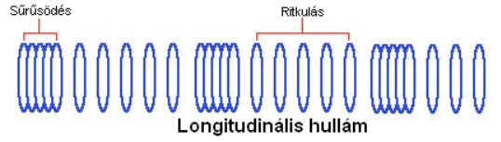
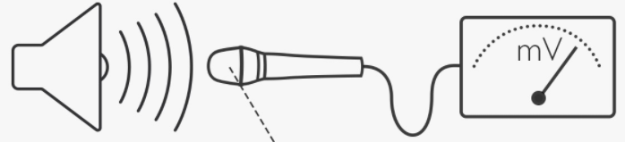
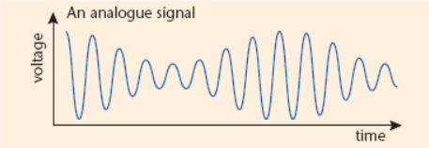
Analogue Signal
Speech = longitudinal wave of the air (changing pressure)
A microphone convert the changes of pressure into changes of voltage
The signal of the mike is analogue:
it is continuous along both axes
(it is interpreted in any time instance
and it may take any value)

Slide 3
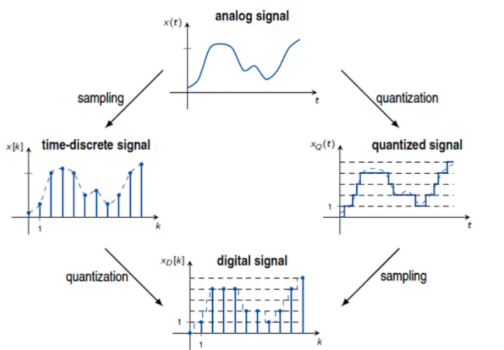
Digitization
The sound card digitizes the analogue signal into a digital signal in two steps: sampling and quantization

Slide 4
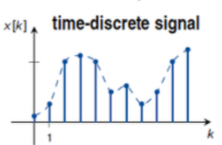
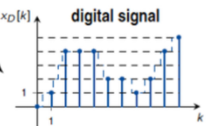
Sampling and quantization
Sampling: we measure (sample) the signal at equal time instances, this is how we obtain the discrete-time signal
  sampling frequency, sampling rate: the number of samples taken in one second
Quantization: for storage, the samples should be converted into some standard form of numeric representation, e.g. signed integers
  8 bit: 0-255
  16 bit: -32768 – 32767
  24 bit:

Slide 5
How many bits for quantization?
The rounding error of quantiazion cannot be reconstructed
But we can increase the resolution relatively cheaply: adding 1 bit increases doubles the number of different values that we can represent
The number of quantization bits defines the dynamic range that we can re-present (the difference between the loudest and softest sound we can store)
  If the sound is too soft → 0 0 0 0 0 0
  If teh sound is too loud → max max max (cutting occurs)
Storing the softest sound that can be heard and the loudest that we can bear without injury would require 20 bits
The dynamic range of speech is 11-12 bits
audio CD: 16 bits
professional studio tools: 24 bits
Remark: during signal processing we requentl apply a floating point representation (eg. 4-byte float)

Slide 6
Sampling
During the sampling process we lose the values that fall between samples
Compared to quantization, saimpling is more „expensive”: if we double the sampling rate, the data amount also doubles
Can the original continuous signal be reconstructed from the samples?
How should we select the optimal sampling rate?
The above two questions are answered by the sampling theorem
But for that, we should first get familiar with the Fourier-transform

Slide 7
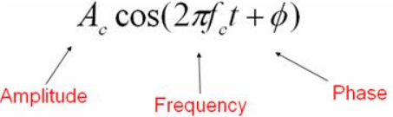
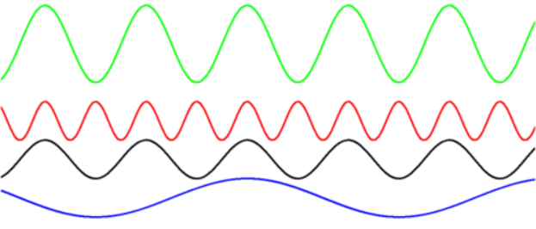
Fourier analysis
The Fourier transform can decompose any signal into the weighted sum of sine waves
Sine wave (remark: sin and cos are the same, apart from a shift):
From the 3 parameters, 2 s derectly interpretable by our hearing:
  Amplitúdó ~ loudness
  Frekvencia ~ pitch
  Phase: our hearing is relatively insensitive to phase
Discrete Fourier Transformation (DFT) is its version for digital signals
Its fast ( O(nlogn) ) implementation is called Fast Fourier Transform (FFT)
Also used in image processing, though sine waves make less sense for images

Slide 8
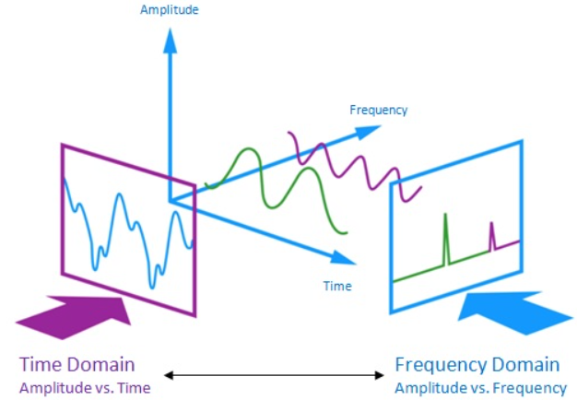
(Amplitude) Spectrum
The FFT decomposes a signal into a sum of sinusoid components
It finds the amplitude and phase of each frequency component
We usually display only the amplitudes, this figures is called the spectrum
time-domain signal spectral image

Slide 9
The sampling theorem
A continuous signal can be reconstructed from the discrete samples, if
  The signal is bandlimited (taking its Fourier transform, the will be a frequency f_{c} so that for all larges frequencies the amplitude is 0)
  The sampling frequency f_{s} is selected so that f_{s}>2f_{c}
In practice the theorem gives us two options:
  We indeed find the largest frequency component f_{c} , and adjust f_{s} accordingly
  If there is no such f_{c}, or it is higher than f_{s} /2 for the f_{s} we intend to use , then we can still use it, but we should discard any component above f_{s} /2
Selecting f_{s} in the case of music or speech:
  The upper limit of human hearing is about 18000-20000 Hz (worsens with age)
  Audio CDs use a sampling rate of 44100Hz, studio tools use 48000Hz (or even 96000Hz)
  In speech, the highest frequency component is about 6-8 kHz, sof for speech a sampling rate of 16 kHz is sufficient
  But we can also go lower, for example, phones use a sampling rate of 8 kHz, so they transfer only up to 4 kHz → slightly distorted, but intelligible

Slide 10
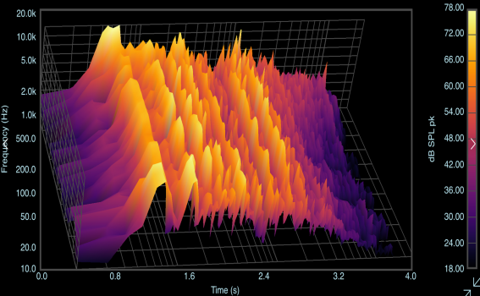
The spectrogram
Spectral analysis make sense only when the signal does not change during the analyzed section
So we typically analyze speech in little chunks (so-called frames)
The standard window size for frames is 10-30 ms, as speech stays relatively stable in such a short duration
Performing the spectrum analysis over these little chunks, and putting the resulting images side by side, we obtain the so-called spectrogram:

Slide 11
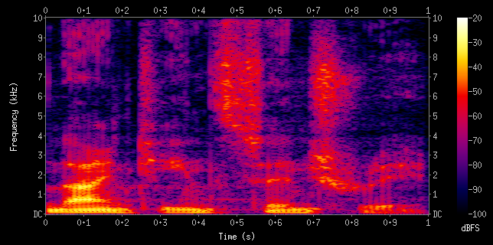
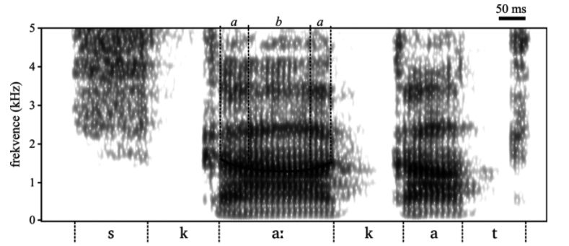
The spectrogram
The spectrogram is 3-dimensional (time-frequeny-amplitude), but the standard way is to display it in 2D (time-frequency), representing the amplitude by colors or grayscale values
The spectrogram is the oldest, most widespread method of visualizing speech signals, a very basic tool in both phonetics and speech technology

Slide 12
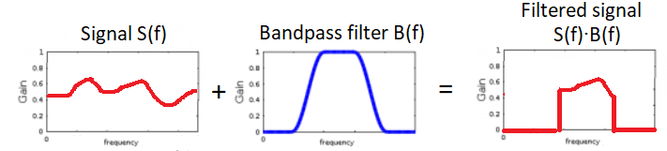
Digital filters
Filters allow us to modify the spectral content of a signal by changing the amplitude of each frequency component
  Each component can be increased or decreased (even wiped out)
  But we cannot introduce new components
We can define a filter by specifying its transfer characteristics (in the simplest case, its amplitude response)
The spectrum of the output signal is defined as the multiplication of the input spectrum and the filter amplitude response
  Eg. bandpass filter:

