Slide 1

Factors of speech communication
(or: why is speech recognition so difficult?)
Tóth László
Számítógépes Algoritmusok és Mesterséges Intelligencia Tanszék

Slide 2
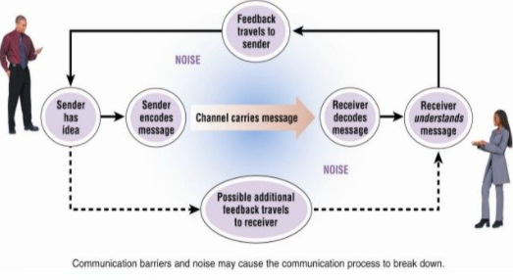
Speech communication
Speech = code:
The speaker transforms his thoughts into speech: „coding”
The receiver transforms the speech back into thoughs: „decoding”
The communication is transmitted through a noisy channel
Besides the actual message, both parties continuously receive feedback
  About the other (eg. if we see him/her: face, gesticulation)
  About the environment, eg. the channel (we hear the backgorund noise)
  About the context (eg. situation)

Slide 3
The building blocks of speech
Speech sound or phone: the smallest speech segment that can be pronounced
  any distinct speech sound, regardless of whether the exact sound is critical to the meanings of words
  Theoretically it is language-independent
phoneme: hte smallest unit that can make two word different.
  a phoneme is a speech sound that, in a given language, if it were swapped with another phoneme, would change the meaning of the word.
  Language-dependent, because certain differences matter in certain languages, while not in others
So, if two speech segments sound different , then they are different phones
If there are two words (in the given language) that differ only in that given phone, then the phone is also a phoneme at the same time
allophones: the two phones sound different, but this difference in not important (forms no different words ) in the given language

Slide 4
Phones and phonemes
t and d: these are phonemes in English, because: kit-kid
In Hungarian, some people on the countryside still use the closed ë phone, but it makes no difference in current, official Hungarian, so it is an allophone: leesett-lëesett
pun and spun in English: the p (aspirated and non-aspirated) are allophones
Remark: many untrained people don’t hear the difference of allophones, because this is not required for language understanding
Summary: the phone set of all human languages is universal (assuming that we are able to hear the differences…)
  However, the phoneme set of each language might be different!
Phonetical transcription of speech: International Phonetic Alphabet, IPA
Computerized version: SAMPA (and X-SAMPA)
  Developers of speech recognition systems in many cases use their own annotation system, and mix the notion of phone and phoneme…
  R. Moore: On the Use/Misuse of the Term ‘Phoneme’, Interspeech 2019.

Slide 5
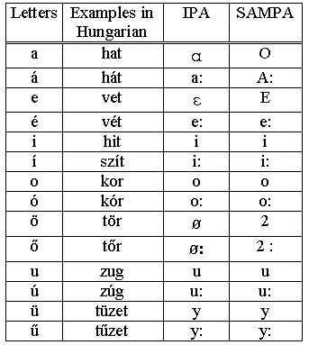
IPA and SAMPA
Example: Hungarian vowels; for the full table see the Internet

Slide 6
Phonetic transcription
For speech recognition, we will need to convert from ortographic transcript to phonetic transcript
Is that difficult? It depends very much on the language:
  English: very difficult, lot of irregularities, huge differences between the written and the spoken form, this is why the dictionaries contain the spoken form (in IPA code!)
  French: the written and the spoken form is quite different, but the conversion is regular
  Hungarian, German: the written and the spoken form is quite similar, but not totally
  Serb: “write what you say and read what you wrote„
Hungarian: the conversion can be done almost perfectly by rules
  The are mostly assimilation rules for groups of consonants
  Problematis cases (these require morphological analysis):
    Double letter or word boundary?, eg.: pácsó
    Assimilation between stem and tag, eg: látja vs. átjár
    Silence between words: more a stilistical problem („lát jános?”- „látjános?” – „láttyános?”)
Hungarian Pronunciation Dictionary
  Web ???

Slide 7
Phones
The main types of phones: vowels (and diphtongs), closures, fricatives, affricates, nasals, other
  We will see examples in the practice
What is the difference between the phones?
  How can our ear differentiate them?
  How can we analyse and recognize them using computers?
  We will have a great visualization tool, the spectrogram (speech→image)
  It will turn out that our ear also performs a similar spectro-temporal analysis
The phones are coded in the signal by so-called acoustic cues
  vowels: formants; closures: place of energy burst; etc.
  Experts are able to read the spectrograms reasonably well
However, the same phone may have different looks, decoding is surprisingly difficult
  We will apply machine learning: we will find the rules of the cue→phone mapping automatically, based on huge amounts of training examples
  Machine learning seeks to operate with the least possible data-specific (in this case, speech specific) knowledge
  This contradicts the general goal of science, that is, gaining understanding…

Slide 8
Why is speech recognition difficult
Naive approach: let’s cut the speech signal into segments, and then try to identify those segments („segmentation and labeling”)
  Segmentation and labeling are both very difficult
  The boundaries are not clear, and the same phone can look very different
The inherent source of variance: coarticulation
  Our articulatory organs change their positions continuously, so the neighboring phones influence the pronunciation of the actual phone
The „outer” source variance: besides the message, the speech signal codes many other things as well
  Acoustic variability: background noise, distortion
  Between-speaker variance: pitch, size of head, talking speed, accent, dialect,..
  Within-speaker variance: mental and physical state (emotional load, age, illnesses,…)
  If we want to extract only the message, then the above factors are noises for us

Slide 9
Levels of Speech Communication
So far we focused on the phones and their coding
However, in a normal communication situation the message should make sense at higher levels, which levels hierarchically build on each other:
  The speech signal codes phones (acoustic phonetics)
  The speech phones correspond to phonemes, which should fit the code system of the actual language (phonology)
  The phonemes should form words (lexicon, morphology)
  The words should form sentences (syntax)
  The sentences should have a meaning (semantics)
  The speaker wants to express something in the actual situation (pragmatics)
If we took care only of the lowest level, then the operation of the speech recognizer would be similar to transcribing nonsense speech (or speech in some foreign language that sound similar to our own language)
In human speech understanding the higher levels play a very important role
  So a speech recognition systems also needs a language model (syntactic model, semantic model, dialogue model) besides the acoustic model

Slide 10
Why is speech recognition difficult 2
The same piece of information can be present at many levels at the same time
  This redundancy is very helpful for both human and machine speech recognition
However, in a normal talking situation we try to reduce this redundancy
  We are trying to speak with the least effort
  With put only the minimum necessary information into our speech, and the place of this information may constantly shift between the levels
How do we know what is the “minimum necessary”?
  We continuously check the partner and the environment (does he understand?)
  We continuously get feedback from the partner („please repeat it slower/louder”)
No feedback: we must speak with larger redundancy, decoding is easier
  In such situations speech recognition is close in accuracy to humans,
  eg. broadcast news
In recognizing conversational, spontaneous, noisy speech the computer is much worse yet

Slide 11
Examples for the interaction of the levels, and for feedback
„What was that?” – situation and context helps understand such sentences
„We inform our passengers that the train arriving from xxxx will be xxxx minutes late”
Etimology of words with alien origin: szamosztrej→számszeríj, durchdefekt→durrdefekt
Funny example of how language expectations can influence what we hear: https://languagelog.ldc.upenn.edu/nll/?p=41249
Lombard effect: in noisy environments we use a more tiresome, but more efficient (understandable) pronunciation
Our brain fuses the information not only from the different level s and the feedback, but sometimes also from other modalities (eg. vision)

Slide 12
McGurk effect
What we see influences what we hear
example: https://www.iflscience.com/brain/what-the-hell-is-going-on-in-this-tiktok-audio-illusion/
More scientific explanation: https://www.youtube.com/watch?&v=G-lN8vWm3m0

Slide 13
Factors that influence the difficulty of automatic speech recognition
Quality of the acoustic environment
  Is there any background noise and what kind (stable of changing)
  Is there any channel distortion (eg. telephone, far-field microphone)
What is the speaking style?
  Isolated commands only, or continuous speech
  Read-planned-spontaneous?
One speaker or many? If the latter, is speaker adaptation possible?
How much constrained are the sentences linguistically?
  Size of vocabulary?
  (small: max. 1-2 thousand words; mid: 5-10 thousand; large: >100 thousand)
  Linguistical constraints?
  Is the text domain-specific?

