Slide 1

Statistical Natural Language Processing
Tóth László
Számítógépes Algoritmusok és Mesterséges Intelligencia Tanszék

Slide 2
Formal language models
By „formal methods” I will mean the formal, generative grammars proposed by Noam Chomsky
  Generative grammars, Chomsky language hierarchy, automata, context-free grammars, context-dependent grammars, …
  The introduction of generative grammars brought revolutionary changes in many areas of linguistics since the a 60’s
  However, it also receives more and more critics as time goes by
This theory has a lot of aspects from the point of linguistic, cognitive psychology, philosophy…but here I will focus only on their practical usability in computational linguistics
  And from this aspect, formal languages does not seem to be the best approach – I’m going to list several arguments on the following slides

Slide 3
Drawbacks of formal language models
There exists no formal language model for any natural language that would describe the whole language
  Creating formal grammars is very difficult even for small parts of the language
Generative grammars describe a given state of the language, they are not able to handle the changes
  Their definition assumes, the set of terminals (in our case, words) to be given
  However, in natural languages we face new words almost each day – the most trivial example is the case of proper nouns
  We, humans are usually able to decode a sentence even when it contains an unknown proper noun, eg. : „Yesterday there was an earthquake in Bergamo, Italy” – Even if we have never heard about Bergamo, from the context we can guess that it must be a proper noun, a city name
  But a formal language would reject the whole sentence
  It would be impossible to prepare a natural language application for all possible names in the word (handling proper nouns or “named entities” is one of the most difficult topics in natural language processing)

Slide 4
Drawbacks of formal language models 2
In spontaneous communication syntactically incorrect sentences are surprisingly frequent
  This is true for speech (spontaneous conversations): incorrect sentences, word repetitions and re-starts, hesitation, and so on
  And also in written communication (blogs, chats, social media): incorrect sentences, typos, abbreviations and so on
  Researchers used controlled material (eg. Proof-read books of read texts) for a long time, so they realized this fact relatively lately
  Interestingly, in normal communication usually we don’t even realize the presence of these errors (only when there are too many of them, so the message can’t get through)
  But a formal grammar would not accept these syntactically incorrect sentences

Slide 5
Drawbacks of formal language models 3
Formal grammars model only the syntax of a sentence
  And they have only 2 „levels”: a sentence is either part of a language or not
They don’t care about semantics and pragmatics
  When two sentences are both correct, then they can’t tell if one of them is
  “more correct” in the actual context or situation than the other
    „See you later, professor” or „Hello, my darling”
  Or when of the sentences is syntactically more probable then the other
    „Computers can recognize speech” vagy „Computers can wreck a nice beach”
To support speech recognizers, a model that can return probabilities between 0-1 would be more useful than a model that return only 0 or 1
  For example, when the acoustic model can’t choose between two very similar sounding sentences, see previous example
The Bayes decision rule I presented at the introduction of HMMs also assumes a language model that estimates P(w₁…w_{n})
  Because of the reasons presented, we will use probabilistic language models

Slide 6
Statistical natural language modeling
These approaches became popular from the 70-80’s after facing the failure of formal methods in practical applications
  Jelinek: "Every time I fire a linguist, the performance of the speech recognizer goes up".
  Nowadays, the majority of practical solutions are based on statistical methods instead of rule-based approaches
We are going to create mathematical (statistical) models for the language – or, at least, for a certain aspect of the language
  The model should be usable – it should be able to describe the phenomenon it models
  But it should remain mathematically tractable, so is cannot be too complicated
  (see the steps of training and evaluation)
  We will find the optimal parameters of the model statistically, by performing machine learning on huge linguistic databases (called “corpus” in linguistics)

Slide 7
Statistical natural language modeling 2
The main types of application for these models:
  Language models: estimating the probability of a “sentence” (sequence of words)
  (this is what we need in speech recognition)
  Linguistic analysis or parsing: finding the most likely inner structure of a sentence
  (e.g. derivation tree)
  Estimating some abstract property of a word (e.g. semantic similarity)
Some important application areas of statistical language models
  Speech recognition, chatbots
  Machine translation
  Text mining, eg. analysis of social media (extracting te opinion or the intent of the user), recommender systems,…
Advantages of statistical models
  They handle syntactics and semantics in one (in language modelling it is an advantage,
  in linguistic analysis it may be drawback in some cases)
  It is able to handle the input even when it was not seen during draining or is incorrect
  (it does not not reject such input, only assigns a lower probability)
  When it makes a mistake, it will be less harmful for the whole system (it will not reject
  the sentence, just assign a too small or large probability to it)

Slide 8
The main statistical properties of natural languages
Tóth László
Számítógépes Algoritmusok és Mesterséges Intelligencia Tanszék

Slide 9
Number of words
Before starting statistical modelling, let’s get familiar with the most important statistical properties of natural languages
  We will mostly talk abut English, and a little bit about Hungarian and German
A seamingly simple question is, how many words do natural languages have?
  English: a “word” is anything that can occur between two spaces
    One word can take only 2-3 forms, eg. go-goes-went-gone, pen-pens
    English has a lot of local variants and dialects (and these might have words that are unfamiliar for the rest of the world)
  Hungarian: because of inflections, even the definition of “word” is not trivial
    Because of morphology, it is more correct to talk about word forms instead of words
    One noun can take about 700 forms! (similar morphologically rich languages are Turkish or Finnish; other European languages fall between English and Hungarian)
    There are many possible words forms that are syntactically correct, but are useless in practice – shall we consider these as real words??
Different estimates on the number of words are quite different
  English: the number of word is somewhere between 150 000 and 2 million

Slide 10
Text Coverage
The notion of covering is more precisely defined, so it is a more useful metric for language technology purposes
  Let’s fix a dictionary with N words
  And take a huge text database with M text words (M is the number of „word positions”, so now the same word at a different position counts to be different)
  Covering calculates the percentage of the text words of M that are present in the dictionary
Examples:
  All of Shakespeare’s writings contain about 29000 different words
  An old examined the inner mailings of a large company, and it was found that
  5-20 words are enough to achieve a covering rate of 90-98% (English!)
This means that in English 5-20 words are enough for normal communication
  However, these 5000 are terribly domain-dependent
  The 5000 most frequent words od medical book will be very much different from the 5000 most frequent words of an engineering text

Slide 11
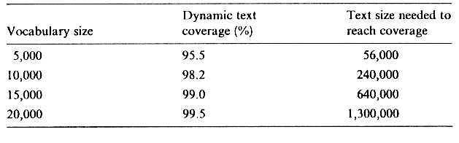
Dynamic coverage
We refine the previous method for coverage: we create a dynamic dictionary
  We process the text from the left to the right
  The dictionary will be dynamic: it will always contain the most recent L different words of the text processed so far
  We check whether the next word is present in the dictionary or not
    If it is not, we add the word to the dictionary and remove the oldest word
  We define dynamic coverage as the average of the word-level coverages (0,1)
Dynamic coverage values (by Jelinek) for the inner mailing of a company:
  "Text size needed to reach coverage”: how long text was required on the average to find L different words (time distance between the oldest and the newest word).
  When increasing L, this value increases non-linearly, which means that the distribution of words in the corpus is very far from uniform

Slide 12
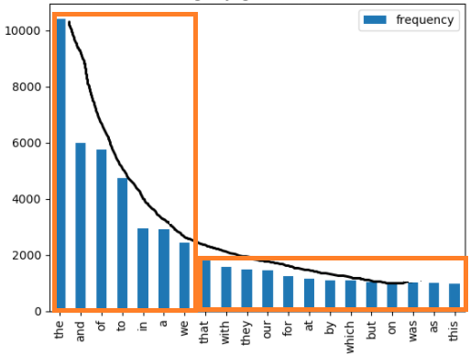
Word frequency distribution
For a large enough corpus we can even display the frequency of each word (blue columns).
  X axis: frequency index (most frequent,
  second most frequent,…)
  Y axis: frequency (number of occurences)
Zipf’s law: the distribution is approximately
1/x (black curve)
  That is, x · y ≈ constant
  „power law”, „long-tail distribution”
Rude approximation (orange boxes): There
a few words that are very frequent, and a lot of words that are very rare
  In practice, approximately half of the words occur only once
  The distribution is scale-invariant, so collecting a larger corpus does not help, the long tail
  remains: new, even more rare words will appear, with occurrence value of one
  This is very bad news with respect to statistical modelling
  So in statistical language modelling the law of „there is no data like more data” is even more true than in other areas of machine learning

Slide 13
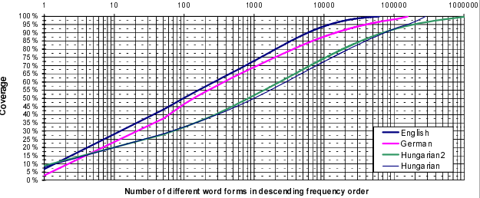
What about Hungarian?
A study compared the coverage rate of English, German and Hungarian
  All the corpora used contained 1-3 million text words
  1 English, 1 German and 2 Hungarian corpora were compared
  Vertical axis: coverage
  Horizontal axis: dictionary size (obtained by taking the most frequent words of the corpus)
  (watch out, this axis is logarithmic!)

Slide 14
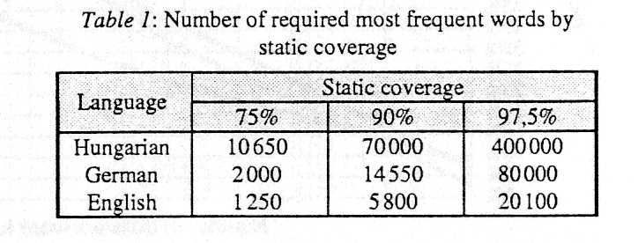
Coverage for Hungarian 2
Some values from the previous figure (numbers of words required to achieve a certain coverage rate):
Conclusion: Compared to English, in German we need 4 times, in Hungarian 20 times lager corpus to attain the same coverage rate
  Presumably, this is the results of word inflection
    It would be interesting to see what would happen if we replaced the words by their stems (would be obtain a curve that is more similar to the curve of English?)
    Is it true that, on the average, we use only about 20 forms of the same word?
So, for Hungarian, statistical modelling is more difficult than for English
  We could perform morphological decomposition on the words (in my house – ház+am+ban)

