Slide 1



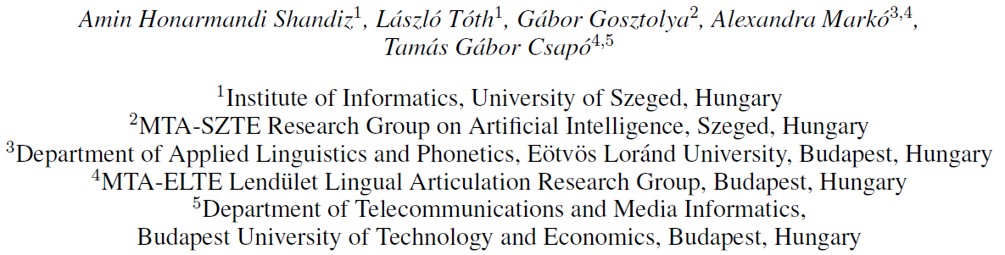
Neural Speaker Embeddings for Ultrasound-based Silent Speech Interfaces

Slide 2
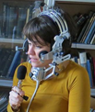

1. Articulatory-to-acoustic conversion
Goal: to reconstruct the speech signal from a recording of the articulatory movement
Data acquisition techniques:
  Ultrasound Tongue Imaging (UTI)
  Electromagnetic Articulography (EMA)
  Permanent Magnetic Articulography (PMA)
  surface Electromyography (sEMG)
  Magnetic Resonance Imaging (MRI)
  lip video, …
Application: Silent Speech Interface (SSI)
  For speaking impaired people
  For extremely noisy conditions
  …
Ultrasound Tongue Imaging (UTI)
  Records a sequence of images (64x842)
  at a frame rate of 82 fps
  Problem: the images are very speaker-specific
The TaL80 database (Renals et al.)
  Parallel ultrasound, speech and lip video recordings from 80(+1) speakers
  Goal of the paper: speaker recognition and normalization experiments

Slide 3
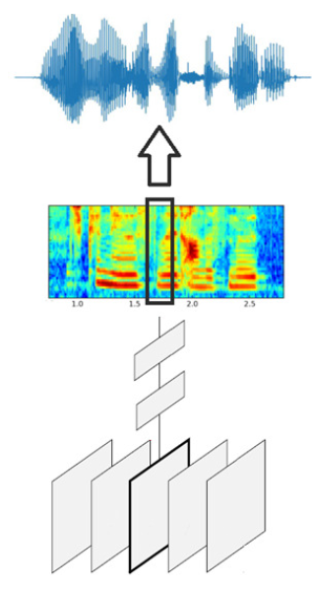
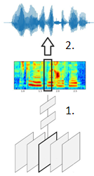
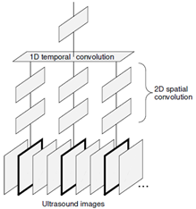
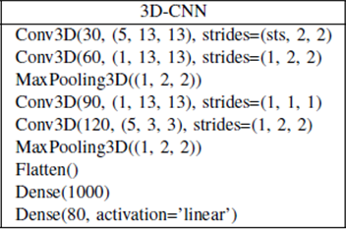
2. Our Current UTI-to-Speech SSI model
Performs the conversion in 2 steps
1st step: A DNN estimates a mel-spectrogram
from the sequence of UTI video frames
  We have synchronized input (UTI)
  and target (speech) signals
  Our DNN operates in a synchronized
  (frame-by-frame) manner
  But sequence-to-sequence mapping
  would also be possible
2nd step: Converting the mel-
spectrogram to a speech signal
  Important task in neural speech
  synthesis
  Large pre-trained DNN models
  exist for this, we used WaveGlow
Structure of the DNN
  Input: a block of 21 consecutive UTI frames
  Output: one frame of the mel-spectrogram
  The network has a special 3D-CNN structure
    Conv3D over 5-frame local blocks, fusing the information along time only at a higher stage
    Motivated by the TDNN popular in ASR,
    and by the ”(2+1)D” CNN model of Tran et al.

Slide 4
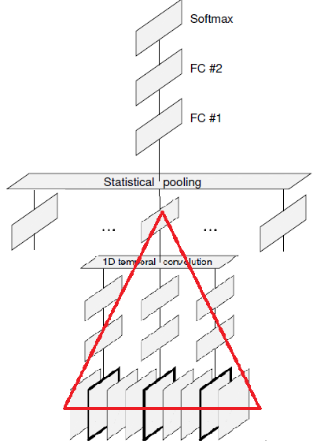
3. Speaker Embedding Vectors
Goal: to extract a vector from each utterance that represents the speaker’s characteristics
  Useful for speaker recognition, or to normalize the sentences wrt. speakers for other tasks
X-vector: a popular solution (for speech signals)
  A DNN is trained to classify speakers
  But it should also work for for unseen speakers
    So an upper hidden layer is used to provide the
    x-vector (instead of the softmax output layer)
  It should give a fixed-size vector independent of
  the input duration
    The network consists of a frame-level part,
    a pooling step, and an utterance-level part
  Typically trained on huge databases with
  thousands of speakers
We adapted the x-vector approach to UTI videos
  Frame-level part: the same structure as the
  3D-CNN used for SSI
  Statistical pooling:
  averaging along time
  Sentence-level: 2 fully con-
  nected layers (FC#1, FC#2)
  Output layer: Softmax
  (size= no. of speakers)
The x-vector is obtained as the
(linear or non-linear) output of
FC#1 or FC#2
The network was trained to
classify speakers
  Training data: samples
  from 50 speakers
  of the TaL80 corpus

Slide 5
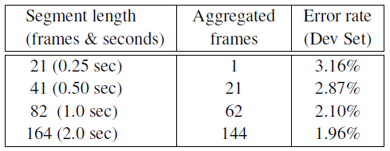
4. Speaker Recognition Results
Speaker classification accuracy of the network
  For the same 50 speakers used for training
  But on an independent development set
  Using the softmax output layer
Error rates as a funtion of the input chunk length
We obtained very low error rates
  Already for short input durations
  Further improvements when increasing the length
Justifies that the videos are very speaker-specific
Does the results generalize to unseen speakers?
  Evaluating the model on the 31 held-out speakers
  The softmax output layer can no longer be used
Recognizing new speakers based on the x-vector
  Would require the building of a complex speaker recognition system, but we wanted to avoid this
Simplest evalutation method: distance comparison of same-speaker and different speaker x-vector pairs
  We used the cosine distance, as it is frequently used in speaker classfication
Another simple method: applying a classifier
  with the x-vector as input
We intentionally used a simple classifier (1-NN)
  sensitive to the underlying data and distance function

Slide 6
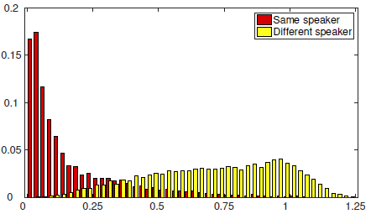

5. Speaker Recognition Results #2
Cosine distances for randomly selected same-speaker and different-speaker x-vector pairs
  For samples from the 31 held-out speakers
There is some overlap
But the distance is typically much larger between different speakers than for same-speaker samples
So the x-vectors behave as expected
Speaker classification results using 1-NN
  Using the cosine distance
  Over the samples of the 31 held-out speakers
We performed leave-one-out experiments:
  For each vector, find the closest one (exluding itself)
  The result was considered correct if the two segments had the same speaker ID
The obtained error rates:
  Extracting the x-vector from either FC#1 and FC#2
  Using either the linear or the non-linear output
  The error rates are low, the x-vector seems to work well for speakers not seen during training

Slide 7
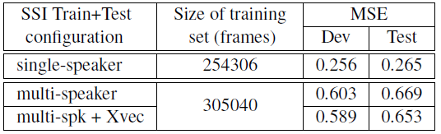
6. Speaker Normalization Attempts
Our SSI system creates intelligible speech with
good quality – in a speaker-dependent manner
  But quality drops drastically for multi-speaker data
Can we use the x-vectors to improve our SSI ?
  Supporting the normalization of the images
  By using the x-vector as auxiliary input (similarly
  to how x-vectors used in ASR)
The optimal combination of the SSI input and
the x-vector is not trivial
  The UTI images should be processed by convolution
  But the x-vector is not an image…
  We processed the UTI and the x-vector by separate layers, combining them only at a higher level (after the convolutional layers)
  But this is quite probably suboptimal
Results: MSE of the SSI network
  Using one-speaker or multi-speaker data sets
  of about the same size
  The x-vector DNN is trained on the 50 speaker set
  The SSI DNN is trained and tested on 31 speakers
  The error of the multi-speaker model is more than double than that of the single-speaker model
  The improvement due to the x-vector is negligible ☹
Conclusion
  The x-vector approach itself seems to be fine
  But the incorporation into the SSI needs improvement

Slide 8


Thank you for your attention!

