Slide 1

The most important notions Of probability theory

Slide 2

Stochastic variables
In machine learning we will work with large tables of data, eg.:
  The measurements (patient name, fever, cough,…) are called „features”
  In different cases (here: for different patients) they take different values
  Mathematically, we can treat them as stochastic variables
Stochastic (or random) variables are variables that can take different values (seemingly) randomly
  Discrete random variable: it can take a finite number of values
  Continuous random variable: it can take infinitely many values
Patient name | fever | cough | …
N.M. | high | …
J.F. | moderate | …
L.L. | high | …
M.D. | no | …
… | … | … | …

Slide 3
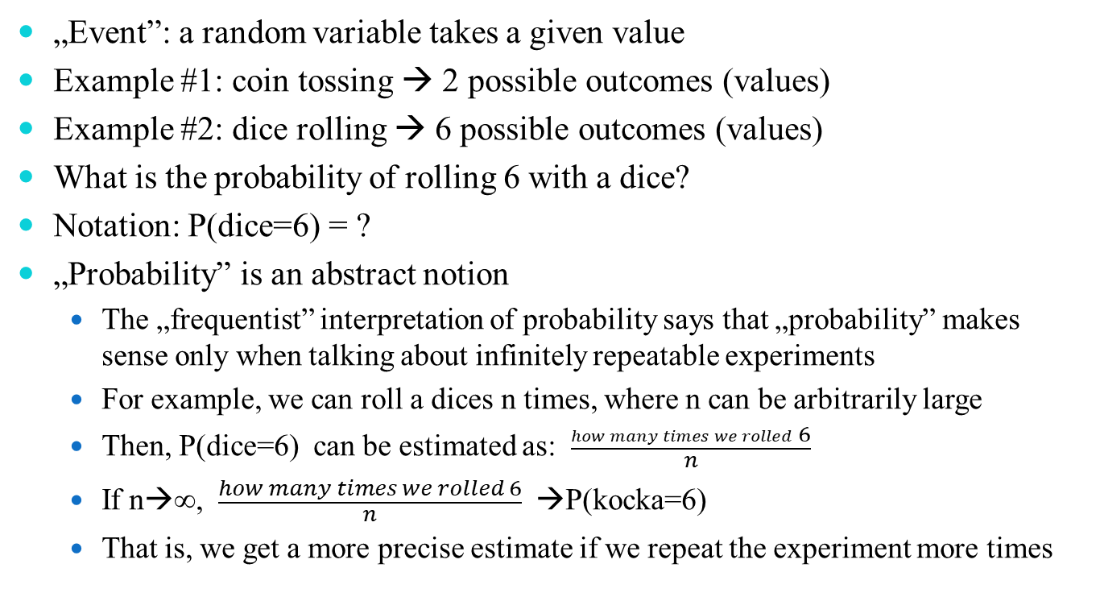
Probabilitiy of events
„Event”: a random variable takes a given value
Example #1: coin tossing → 2 possible outcomes (values)
Example #2: dice rolling → 6 possible outcomes (values)
What is the probability of rolling 6 with a dice?
Notation: P(dice=6) = ?
„Probability” is an abstract notion
  The „frequentist” interpretation of probability says that „probability” makes sense only when talking about infinitely repeatable experiments
  For example, we can roll a dices n times, where n can be arbitrarily large
  Then, P(dice=6) can be estimated as: $\frac{how many times we rolled 6}{n}$
  If n→∞, $\frac{how many times we rolled 6}{n}$ →P(kocka=6)
  That is, we get a more precise estimate if we repeat the experiment more times

Slide 4
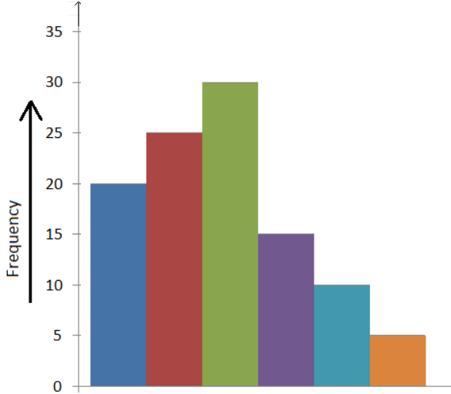
Probability of events
Example #1: we toss a coin 10 times, we get 6 heads and 4 tails
So our estimate is P(coin=head) = 6/10 = 0.6
So our estimate is P(coin=tail) = 4/10 = 0.4
It is easy to see that for a discrete random variable the probability of each possible outcome is between 0 and 1, and the sum if these probabilities is 1
Example #2: roll the dice 100 times →
we can create a histogram from the values
  6 possible values – 6 columns
  Divinding the value in each column by100
  we get an estimate of the probabilities

Slide 5
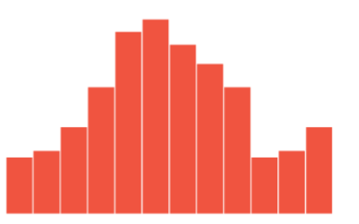
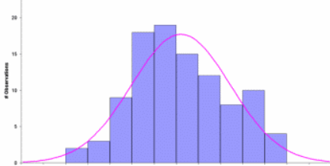
Continuous random variables
More possible values → more columns
in the histogram
More possible values →more experiments are required for an accurate estimate (otherwise we get a lot of 0 in many columns)
Continuous random variable: it has infinitely many values
  Making histograms (counting
  the cases) no longer works
  (only if we cheat by taking a small
  neigborhood around a given point)
  More usually, we assume that the
  distribution of the data points
  follows a specific curve
  (see, eg. the purple curve)

Slide 6
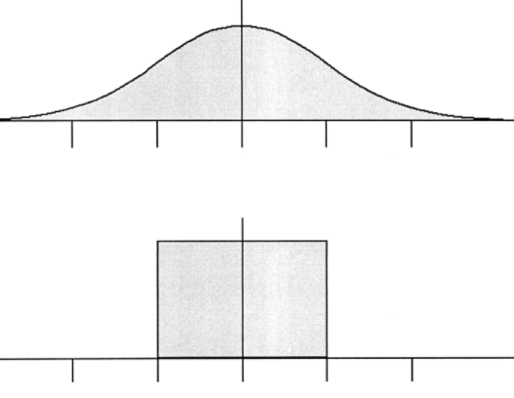
Continuous random variables
The 2 most well-known continuous
distributions:
Gaussian (or normal) distribution:
Uniform distribution:
Compared to discrete distributions, continuous distributions behave weird:
  The area under the curve should be 1 (we need to integrate instead of summing)
  But the probability of taking each possible value P(x=…) is zero!
  So the above curves show the „density” of the distribution and not probabilities
  To emphasize the difference, mathematicians write p(x) instead of P(x)
  (but this rule is not kept in my slides…)
Estimating the parameters of these curves from data is not trivial
  One of the lectures will be about this topic

Slide 7
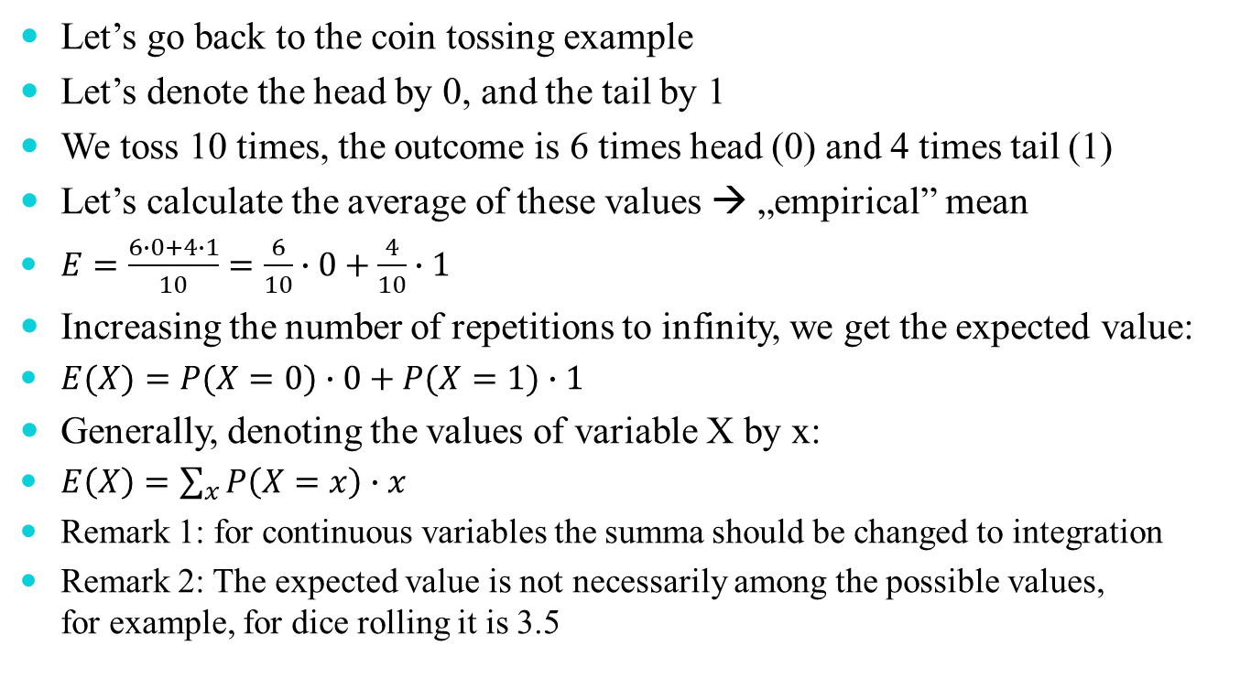
Expected value
Let’s go back to the coin tossing example
Let’s denote the head by 0, and the tail by 1
We toss 10 times, the outcome is 6 times head (0) and 4 times tail (1)
Let’s calculate the average of these values → „empirical” mean
$E=\frac{6∙0+4∙1}{10}=\frac{6}{10}∙0+\frac{4}{10}∙1$
Increasing the number of repetitions to infinity, we get the expected value:
$E(X)=P(X=0)∙0+P(X=1)∙1$
Generally, denoting the values of variable X by x:
$E\left(X\right)=\sum_{x}{P\left(X=x\right)∙x}$
Remark 1: for continuous variables the summa should be changed to integration
Remark 2: The expected value is not necessarily among the possible values,
for example, for dice rolling it is 3.5

Slide 8

Expectation of a function
Let us assume we have a function f(x), where x is a random variable
The expected value of f(x) is defined exactly the same way as the expected value of x, but in the formula we replace x by f(x):
E$\left(f(X)\right)=\sum_{x}{P\left(X=x\right)∙f(x)}$

Slide 9
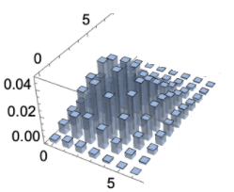
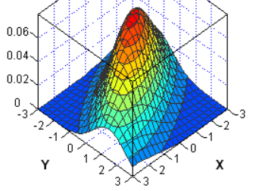
Multivariate distributions
In practice we typically have more than one measurements in the feature vector
Example: we roll two dices together
  Then we can talk about the joint probabilities of two events P(d1=x, d2=y)
  We need a multivariate distribution to describe the distrbution of the possible values
The probability of joint events for indipendent events:
P(cough=dry, fever=high) = P(cough=dry) ∙ P(fever=high)
In practive we very frequently assume that two variables are independent, because it allows us to use the above formula
  Unfortunately, we frequently do this even when we know that the independency does not hold…

Slide 10
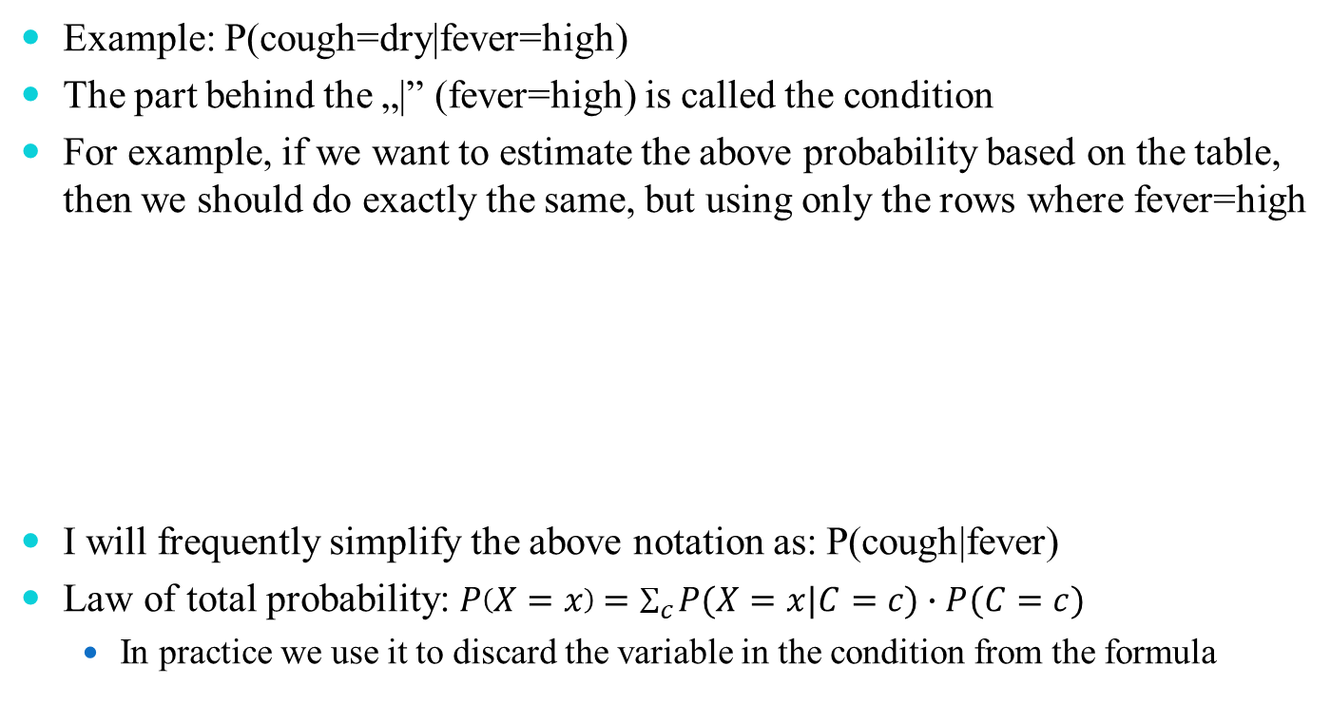
Conditional probability
Example: P(cough=dry|fever=high)
The part behind the „|” (fever=high) is called the condition
For example, if we want to estimate the above probability based on the table, then we should do exactly the same, but using only the rows where fever=high
I will frequently simplify the above notation as: P(cough|fever)
Law of total probability:$P\left(X=x\right)=\sum_{c}{P(X=x|C=c)∙P(C=c)}$
  In practice we use it to discard the variable in the condition from the formula
Patient name | fever | cough | …
N.M. | high | …
J.F. | moderate | …
L.L. | high | …
M.D. | no | …
… | … | … | …

Slide 11

Bayes theorem
A very important rule about conditional probabilities:
We will use it to switch between $P\left(X|C\right) and P\left(C|X\right)$

